Slide 1
Autonomous Vehicles
Should the US proceed with AV development in the face of safety incidents and other possible issues?
Aditya Mengani, Haoyu Zhang, Jeffrey Day, and Luke Verdi
July 14th, 2020
Audience: transit and local government officials, autonomous vehicle company executives

Slide 2
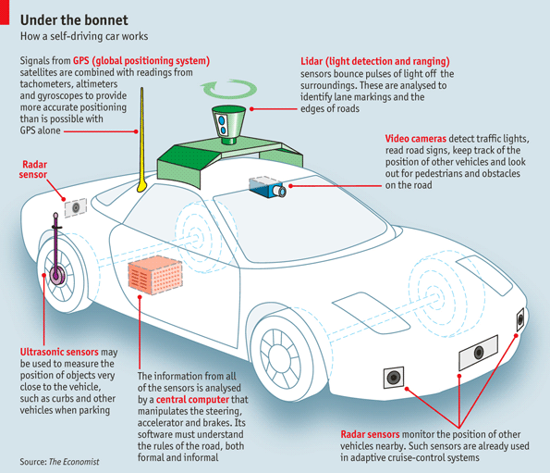
History of Autonomous Vehicles
Alphabet launches Waymo, which within 18 months is capable of driving through some California roads. Tesla, Uber and others follow with investments
The idea and development of autonomous cars can be traced back to demonstrations in NYC with a radio controlled car
2004
2018
1920s
2009
DARPA holds a grand challenge in the Mojave Desert, with a $1 million prize for the team able to complete a 150 mile trek. No one does
An Uber vehicle strikes and kills a woman crossing the road in Arizona, leading to Uber temporarily pulling their cars from streets and new criticism of self driving cars
Notes:
The idea of autonomous vehicles is not new. The idea for a car “driving itself” actually be traced all the way back to 1920, with a car demoed on the streets of NYC which was controlled by remote control by the car behind it. These kinds of “cheats” continued through the 1950s and 1960s, like for example with an experiment in Nebraska where cars would follow an electric track built in under the highway.
What we would think of as Autonomous Vehicles kicked off in 2004 with the Grand Challenge held by DARPA in the Mojave Desert. The goal was to drive 150 miles. No team made it further than 7 miles.
But interest continued, and in 2009 Alphabet launched Waymo, which started to have some success within a few years. Soon after, Tesla, Uber and other joined the quest to create a self driving car with substantial investments.
These investments and progress have continued, but one very noticable event for safety stands out, which is in 2018 an Uber autonomous vehicle struck and killed a woman in AZ. This lead to renewed criticism of self driving cars and their applicability.

Slide 3
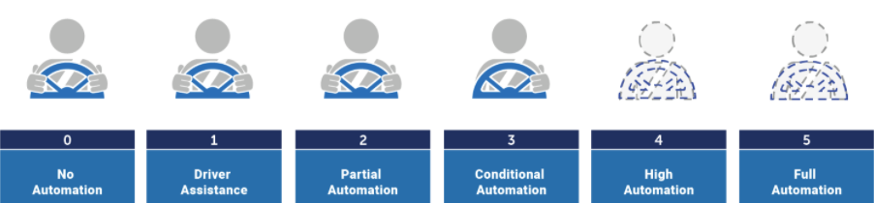
We’re at a major transition point with self driving cars
We’re Here
Historically what driving meant, driver performing all tasks
Systems can start to aid with steering or accelerating (cruise control)
System can begin to perform steering and speed control. Driver still pays full attention
Systems can drive, human must be ready to take back control whenever requested
Systems can drive fully in certain environment, human need not pay attention
Systems can drive fully in all environments, human need not pay attention
Notes:
So one other piece of background information we should understand is where we are as far as the levels of self driving. There are really thought to be 6 levels, starting with no automation, progressing to level 1, which would be singular systems meant to aid the driver, like cruise control or blind spot detection. Then in level two the car can start to control speed and steering, but the driver still pays full attention and is ready to intervene in a moment’s notice, sometimes without warning. In level 3 the car gets better and can alert the driver when help is needed. But here the driver is again alert at all times and ready to take back control. This is where Tesla is now. The cars can drive themselves some, but the driver is still ultimately responsible. A big turning point is level 4, where cars can start to fully drive without the human paying attention. The cars are just limited by only operating within a certain range (say a city or retirement community) or by certain say weather conditions. There are a few of these cars on the streets now, like Waymo cars in AZ, which you can actually sign up to take an Uber in. Finally in level 5 the cars can drive themselves in all circumstances with no human intervetion. We aren’t here yet.

Slide 4
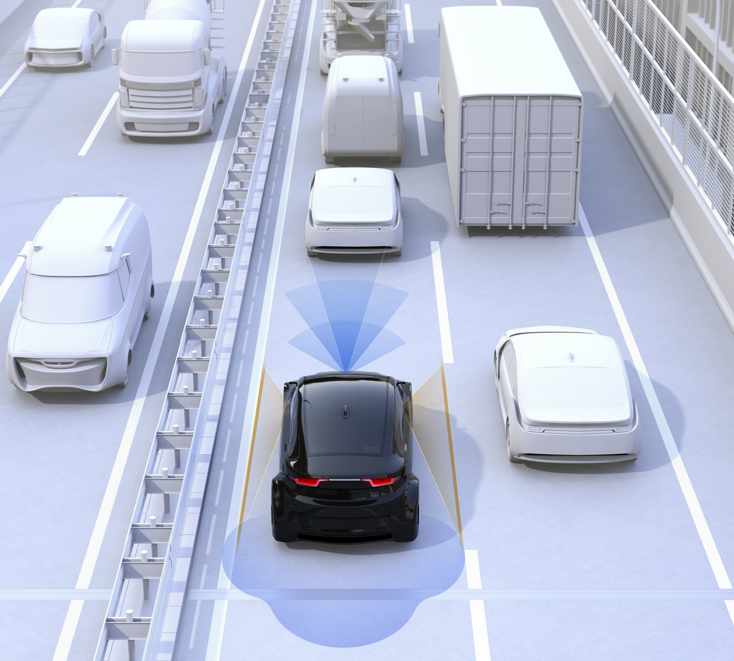
Pros
Groups supporting: Tech Companies/Vehicle Manufacturers/Physically disabled/ Environmentalist
Safer Driving: Avoid car-related deaths, accidents caused by drivers
More productive: No waste of commuting time
Money-smart:Lower accident-induced costs, better fuel efficiency
Notes:
Support/ Beneficiary
Companies Leading in AV (Waymo, GM CRUISE, Argo AI )
Environmentalist, Drivers in congested area, Disabled individuals, Seniors
Not only high tech companies but also traditional vehicle manufactures are among the groups that supporting the self driving vehicles. Among them, Waymo, GM CRUISE, Argo AI, etc are leading in the development of self driving technique. In addition, groups like Environmentalist, residents in congested area, Disabled individuals are more likely in favor of it.
FIrst, Self driving make it possible to avoid car-related deaths. Human-driven car causes huge loss, amounting to about 40,000 deaths annually in the United States. (National Highway Traffic Safety Administration (NHTSA)revealed that) 94% of accidents were caused by the drivers themselves
Self driving is also more productive. In 2018, The average American commuting time was 9 full calendar days a year, and it largely goes wasted. When a computer takes over the driving responsibilities, drivers can use that time to do other things (like catch up on reading or get some work done, or even get a little extra sleep)
Self driving is money smart. AAA reports that the average annual amount spent on a car in US is close to $9,000, part of this cost can be eliminated or reduced with the help of self-driving cars. Because self-driving cars are safer, they’ll cut down on any accident-induced costs. Additionally, self-driving will contribute less car wear, better fuel efficiency compared to human drivers,

Slide 5
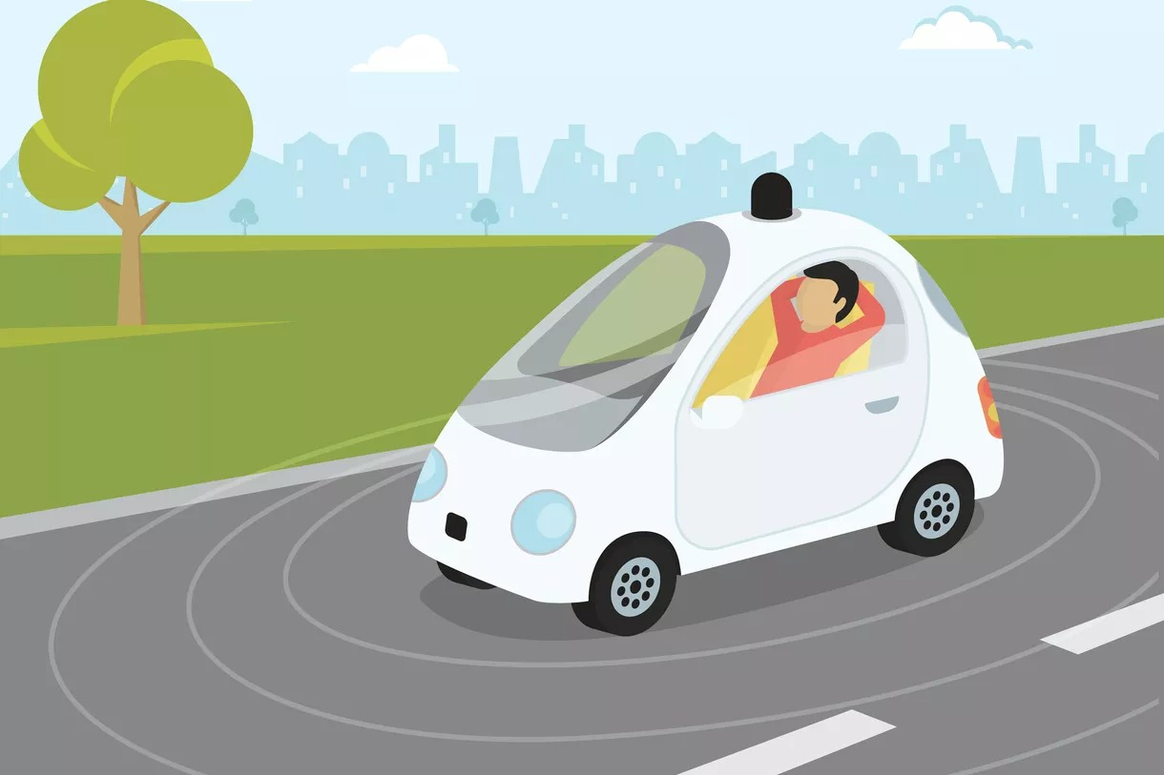
Pros
Easy and efficient travel:
Highly automated, Easy Operate
Environment-friendly:
Less Air pollution, Electric vehicles
Notes:
4. Self driving also improve the travel efficiency. since self-driving cars are highly automated, there is no specialized driving license required to operate this kind cars. (GPS programs will navigate cars to the destination in the fastest possible routine.) Disabled individuals and seniors, (who have to rely on public transportation or assistance from others), could have more freedom and mobility.
5.Self-driving cars could be of huge benefit to the environment, too . (According to the Union of Concerned Scientists,) transportation, in general, was responsible for over half of the carbon monoxide and nitrogen oxide air pollution ( as well as a quarter of the hydrocarbons emitted into our atmosphere). Self-driving’s improved efficiency would help cut down on these emissions. Moreover, If manufacturers of self-driving cars make electric vehicles in the future, the positive impact on the environment could be even greater.

Slide 6
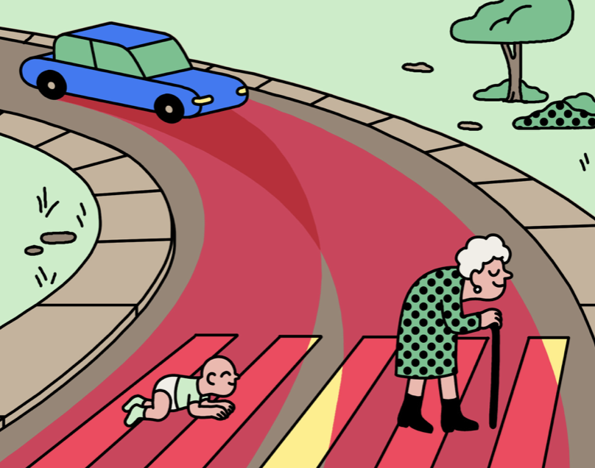
Cons
Groups against: Driver unions / Social activists / Policy Makers / Insurance Industry
Biased algorithms could lead to Racist cars
Fallacies like, AI is reliable / zero maintenance
Legal regulations not fully formulated
Safety & testing procedures not standardized
Notes:
The algorithms could be biased in detecting people belonging to different demographics causing serious safety concerns
Fallacies: Reliability is a continuous process, customer need to still maintain the car similar to the manual cars
Legalities : Still evolving, not many lawyers out there who know about all regulations
Safety and Testing : Different guidelines for testing and deployment of new parts causing confusion
Early stages of evolution : Could lead to accidents blending Manual cars

Slide 7
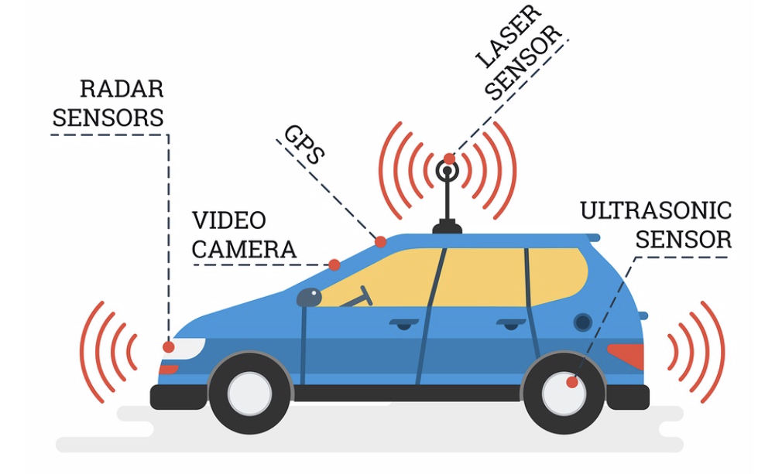
Cons
Cars not evolved for all-terrain
Security Issues due to hacking
Privacy Issues related to data storage
Malfunctioning parts and replacement
Health hazards due to radiation
Notes:
Security Issues: Vulnerabilities related to Hacking causing serious implications to driving experience
Privacy Issues : Data storage and privacy concerns related to data issues (theft of personal information, usage for other purposes)
Parts malfunction : Sophisticated and expensive to replace (cheaper costs could lead to more accidents since the parts are more sophisticated with sensors and circuits)
Health issues : High radiation due to communication of multiple parts
Insurance concerns: Higher premiums due to liabilities, nascent nature and costly parts
All-Terrain : Not evolved for extreme conditions and edge cases
Liability : Rules related to Who is at fault during collision are not laid out properly across all states, causing confusion. Who gets paid during a collision? Who will pay for an accident?

Slide 8
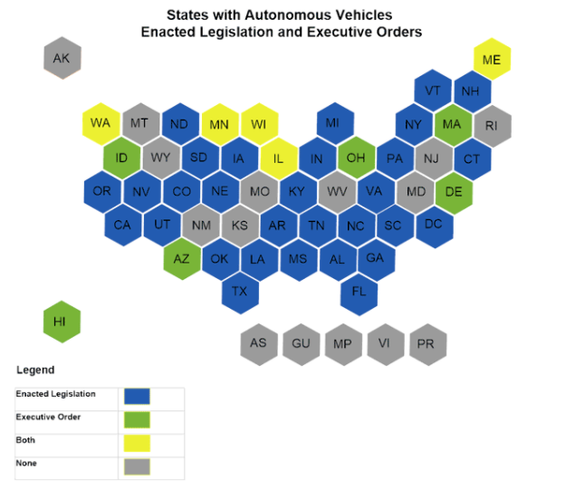
The US is moving forward with autonomous vehicles
Majority of states allow AVs
Uber has returned to self-driving car trials
But, progress has been slower than expected
Disengagement rate continues to fall, still >0
More data/practice is needed
Notes:
So as for who is winning this article, the US is certainly moving forward with AVs. As of 2019 there were 29 states allowing AVs to operate, and even a company with an accident like Uber has returned to operating self driving cars. However, it’s not really a full win for self driving car companies. Progress has been slower than expected. It’s super easy to go find old articles of journalists predicting there would be all self driving cars by 2020 or of self driving car companies promising functionality by a deadline and not delivering. And while companies continue to lower their disengagement rate (which is how frequently a car needs human intervention) it’s still not 0. So in 2018 Waymo had a disengagement rate of 0.09, which means their cars needed intervention just under once every 10,000 miles. That’s fantastic, but still not perfect. The edge cases are really hard to train. More data is needed on that and more of a proof of safety in all situations.

Slide 9

“Third Way” - Technical collaboration between AV companies and local governments
AV companies and governments take mutual responsibility for new transit development
AV data transparency
“Smart” city infrastructure
Notes:
Although autonomous vehicles are in general moving forward, a separate path in their development involves moving forward with significantly more collaboration with local governments.
One key way is through increasing overall data transparency with regards to AV incidents
AVs generate large amounts of data that AV manufacturers consider to be a proprietary advantage. However, anonymized sharing of basic metadata from these incidents (like nature of the environment during a crash, crash specifics etc.) could not only increase understanding of how AVs perform, but potentially fight the availability bias from more recent AV crashes and enhance the public’s understanding of the reality of their safety
A second option is for local governments to focus on applying data science techniques used in AV development to improve transit infrastructures to improve the safety and development of AVs.
For example, in many smart city designs, sensors are embedded in road surfaces that can connect to AV and traffic management systems to improve navigation and flow of traffic
Can also apply these same data science techniques to figure out the ideal way for AVs to fit in the overall transit system, including public transit, cycling, and micromobility solutions

Slide 10
Thanks for listening!
Any Questions?

Slide 11
References:
https://www.rand.org/pubs/research_reports/RR2662.html
https://www.technology.org/2019/02/26/top-5-dangers-of-self-driving-cars/
https://www.hg.org/legal-articles/liability-and-safety-concerns-with-self-driving-cars-43458
https://www.nytimes.com/interactive/2018/02/27/opinion/automated-vehicles-cant-save-cities.html
https://www.technologyreview.com/2018/10/24/139313/a-global-ethics-study-aims-to-help-ai-solve-the-self-driving-trolley-problem/
https://medium.com/@feiqi9047/the-data-science-behind-self-driving-cars-eb7d0579c80b
https://www.vox.com/future-perfect/2020/2/14/21063487/self-driving-cars-autonomous-vehicles-waymo-cruise-uber
https://www.engadget.com/2019-02-13-waymo-self-driving-cars-disengagement-rate.html
https://en.wikipedia.org/wiki/History_of_self-driving_cars
https://www.autoinsurancecenter.com/top-20-pros-and-cons-associated-with-self-driving-cars.htm
https://www.forbes.com/sites/lanceeliot/2020/04/28/luminaries-battle-in-lincoln-douglas-style-debate-about-the-future-of-self-driving-cars/#5ff9f2b328b6
https://www.startupgrind.com/blog/5-reasons-you-should-embrace-self-driving-cars/
https://www.washingtonpost.com/business/2019/10/07/nine-days-road-average-commute-time-reached-new-record-last-year/
https://www.ncsl.org/research/transportation/autonomous-vehicles-self-driving-vehicles-enacted-legislation.aspx#:~:text=Twenty%2Dnine%20states%E2%80%94Alabama%2C,%2C%20Virginia%2C%20Vermont%2C%20Washington%20and

